Slide 2
Objectives
Understand the difference between the Internet and the World Wide Web
Understand how uniform resource locators (URLs) work
Describe the purpose and operation of HTTP and HTTPS in the transmission of web pages
Explain the purpose and functions of a web browser
Understand the use of HTML in displaying web pages

Slide 3
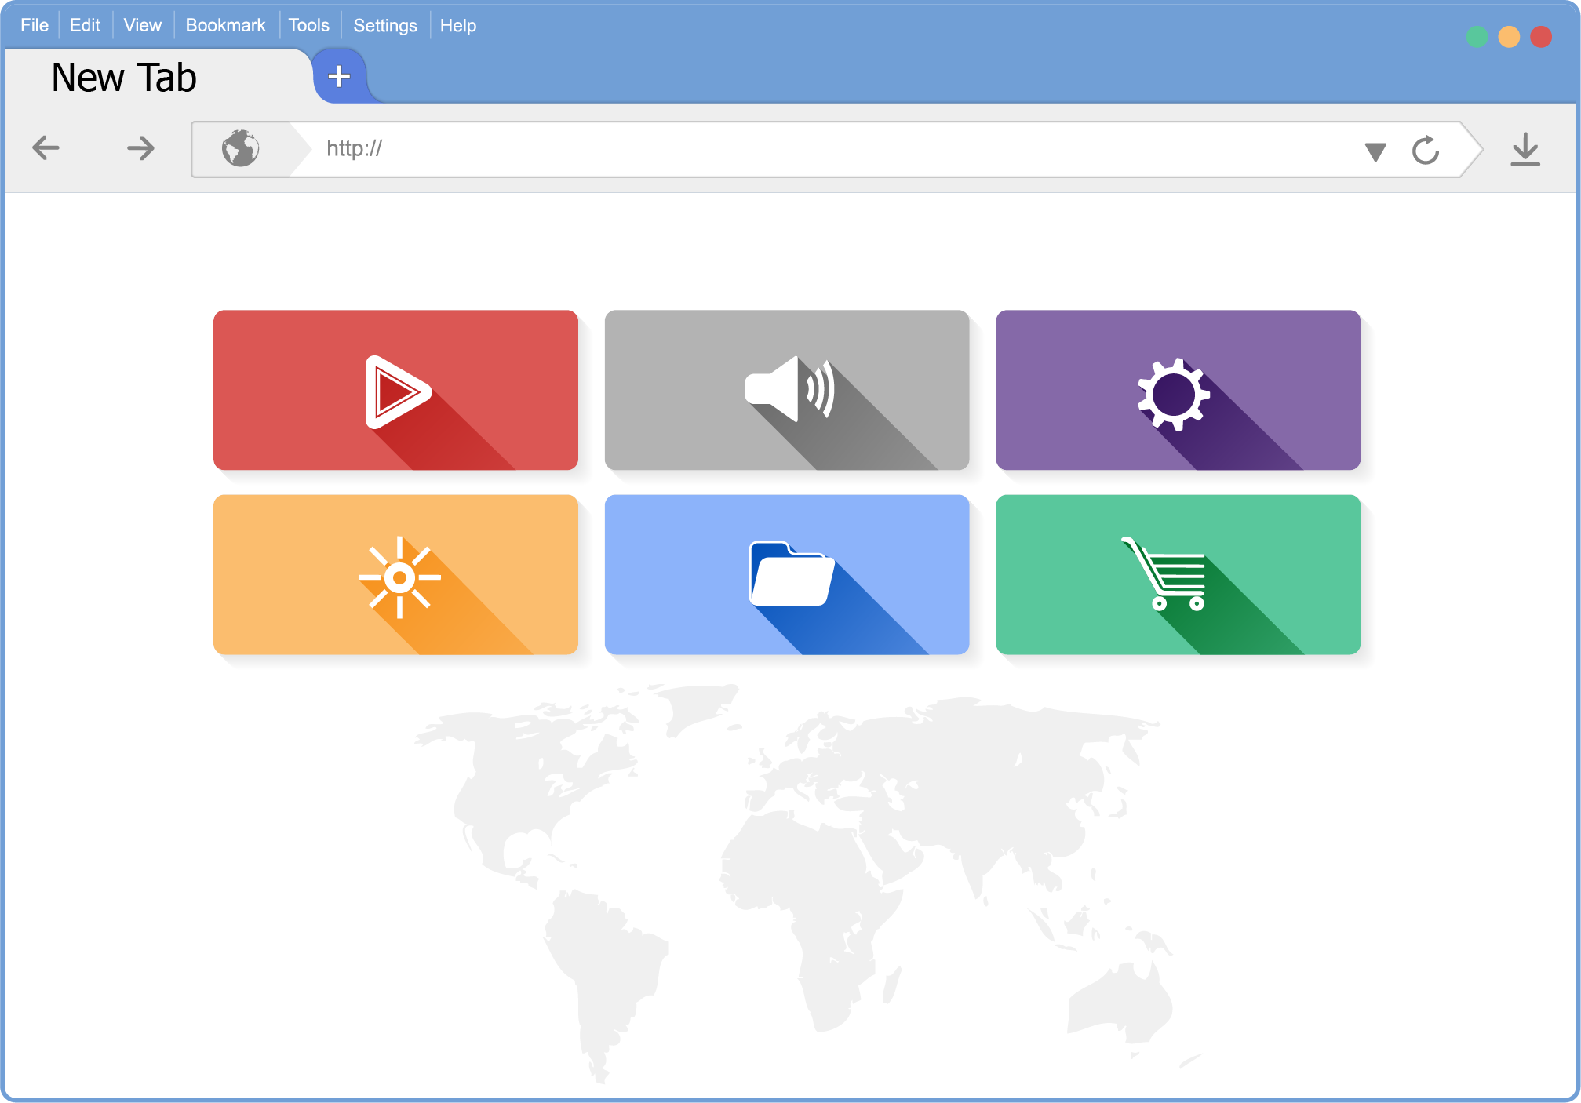
Starter
Work in a pair to list as many features that web browsers contain
List at least three features

Slide 4
Starter
Features of web browsers
Storing bookmarks and favourites
Recording user history
Allowing use of multiple tabs
Storing cookies
Providing navigation tools
Providing an address bar

Slide 5

Address bar and navigation
The address bar allows the user to enter a web address
If the user doesn’t enter a protocol such as HTTP or HTTPS, the browser will automatically assume it is one of these
Remember that browsers allow navigation such as previous page, next page and refresh page

Slide 6


Bookmarks and favourites
Users are able to store a list of bookmarks of sites they want to visit again
Bookmarks are also known as favourites in Microsoft web browsers
Bookmarks may be organised into folders to make them easier to access

Slide 7

User browsing history
Web browsers keep a record of all web pages that users visit
Each of the pages are recorded along with the time and date they were accessed
This allows the user to scroll through and search their browsing history to find web pages they have recently visited

Slide 8
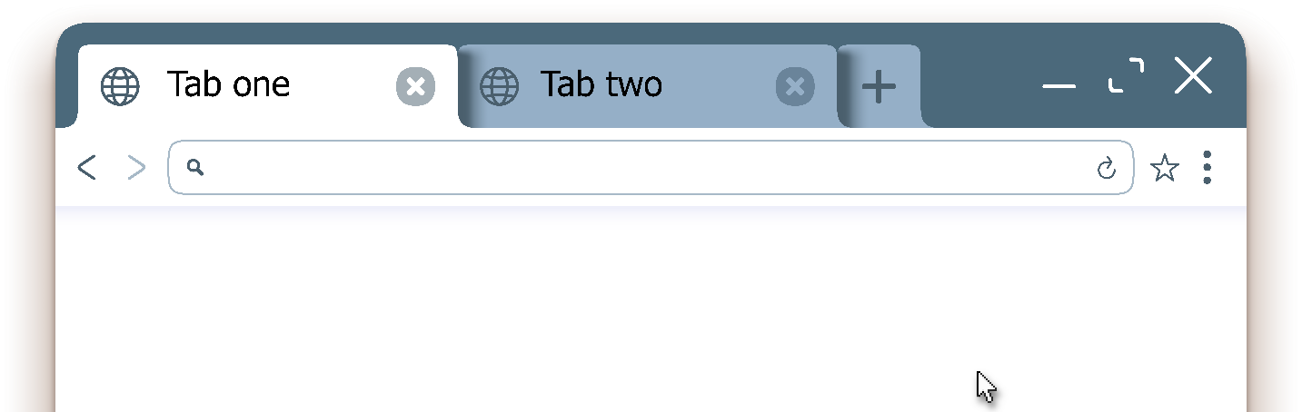
Tabs
Tabs are a user interface feature that allow many web pages to remain open at the same time
The user is able to quickly select different web pages
Before tabs were available in web browsers, users would have a large number of browser windows open which was far more frustrating to use

Slide 9
Worksheet 3
Now complete Task 1 on Worksheet 3

Slide 10

Internet vs World Wide Web
Many people use the terms Internet and web interchangeably
However, the Internet and the World Wide Web are different
Discuss with a partner and explain the difference between the Internet and the World Wide Web

Slide 11
Internet vs World Wide Web
The Internet is the large global network of networks
It refers to the physical network infrastructure that is used for the transfer of data
The World Wide Web (www) is one service for information sharing that makes use of the Internet
It makes use of the hypertext transfer protocol (HTTP) to send the data
The information stored in Hypertext Markup Language (HTML)
Other services that make use of the Internet include
File transfer protocol (FTP), Voice over IP (VoIP)

Slide 12
URL structure
A web address is technically known as a Uniform Resource Locator (URL)
A full web address will specify the protocol that needs to be used, the domain name and the webpage or file name
https://www.domainname.com/images/webpage
Protocol
Domain name
Webpage or file
Hostname
Path

Slide 13

HTTP and HTTPS
Hypertext Transfer Protocol (HTTP) is the protocol used to send webpages
It is unencrypted so not safe for sending personal information
HTTPS (Hypertext Transfer Protocol Secure) is used to send and receive web pages and form data in an encrypted format

Slide 14
HTML
The main purpose of a web browser is, of course, to render (show) web pages
Web pages are written in hypertext markup language (HTML)
<!DOCTYPE html> – specify the document as html
<!DOCTYPE html>
<html>
<body>
<h1>This is a heading</h1>
<p>This is a paragraph.</p>
</body>
</html>
body – start the main body of the page
html – start a new web page
h1 - heading
p – new paragraph
<startTag>
</endTag>

Slide 15


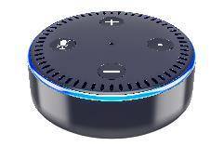
Browser rendering of HTML
The HTML describes the content of the web page
It is up to the web browser to decide how this will be presented
<html>
<body>
<h1>This is a heading</h1>
<p>This is a paragraph.</p>
</body>
</html>
This is a heading
This is a paragraph
This is a heading
This is a paragraph
This is a heading
This is a paragraph
“This is a heading… This is a paragraph.”
This is a heading
This is a paragraph

Slide 16
Worksheet 3
Now complete Task 2, Task 3 and Task 4 on Worksheet 3

Slide 17
Plenary
Write down the meaning of each of the following acronyms
WWW
URL
HTTP and HTTPS
HTML
Create a list of at least five browser features

Slide 18
Plenary
WWW – World Wide Web – the system of information sharing that makes use of the Internet
URL – Uniform Resource Locator / web address
HTTP / HTTPS – Hypertext transfer protocol – used for transmitting web pages / HTTP secure – encrypted version
HTML – Hypertext markup language – used to create web pages
Browser features:
Storing bookmarks and favourites; recording user history
Allowing use of multiple tabs; storing cookies
Providing navigation tools; providing an address bar
Rendering (displaying) web pages

